Slide 1

CS4225/CS5425 Big Data Systems for Data Science
NoSQL Overview
Ai Xin
School of Computing
National University of Singapore
aixin@comp.nus.edu.sg

Slide 2
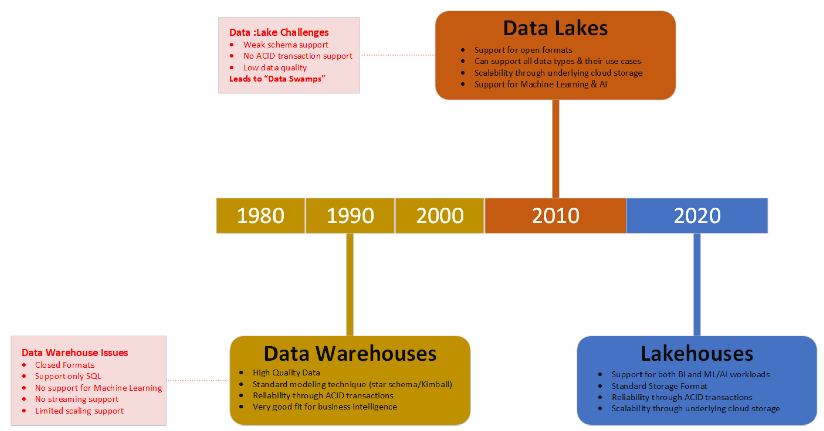
Evolution of Data Architectures
Compute / Analytics
Storage / Data Stores
NoSQL
(2010s)
Spark
(2010s)
Relational Database
(1960-1970)
HDFS
(2006)
MapReduce
(2006)
Delta Lake
(2021)

Slide 3
Today’s Plan
What is NoSQL?
Major types of NoSQL systems
Eventual Consistency
Duplication
Data Partitioning
Query Processing in NoSQL
Source: Cattell (2010). Scalable SQL and NoSQL Data Stores. SIGMOD Record.

Slide 4
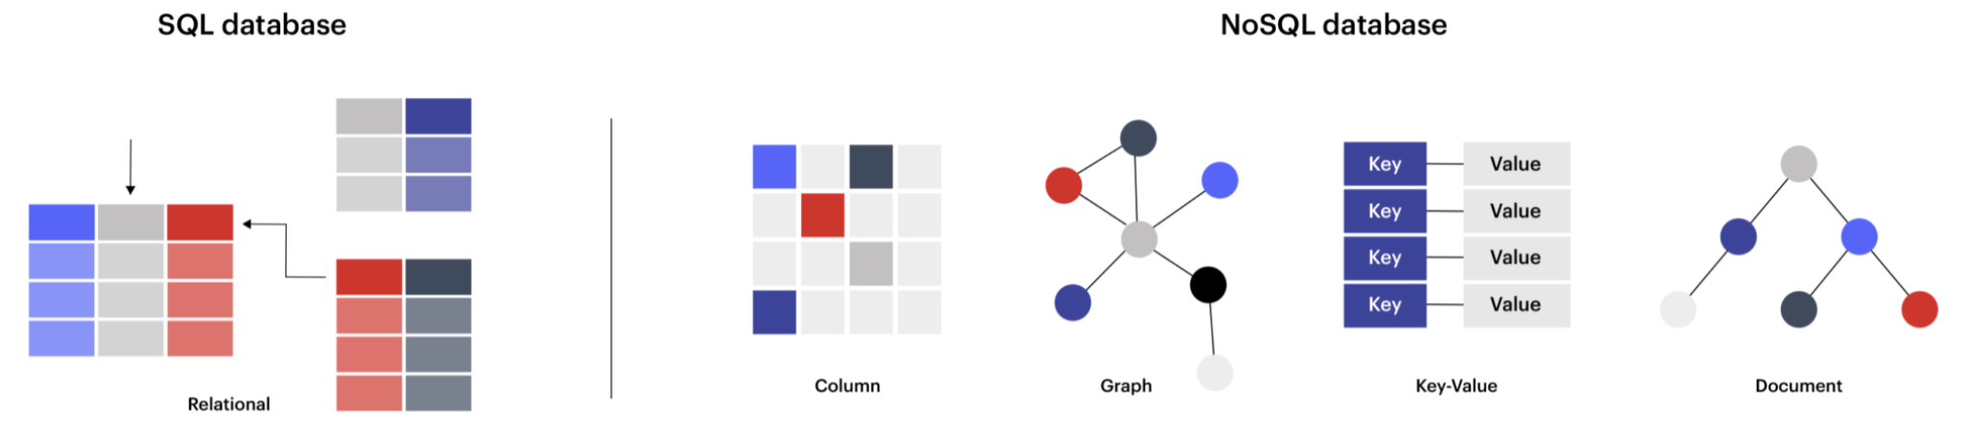
What is NoSQL?
NoSQL mainly refers to open source, distributed, non-relational database, i.e. it stores data in a format other than relational tables
”SQL” here refers to traditional relational database management systems (“DBMS”)
(This is a slight misnomer; here “SQL” is used to refer to relational databases, not the querying language. In fact, NoSQL systems can involve SQL-like querying languages in many cases.)
NoSQL has come to stand for “Not Only SQL”, i.e. using relational and non-relational databases alongside one another, each for the tasks they are most suited for
Notes:
NoSQL: open source, distributed, non-relational databases

Slide 5
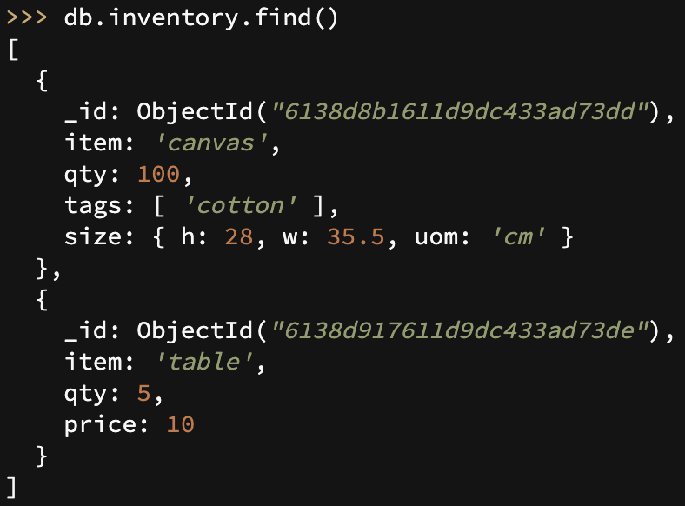
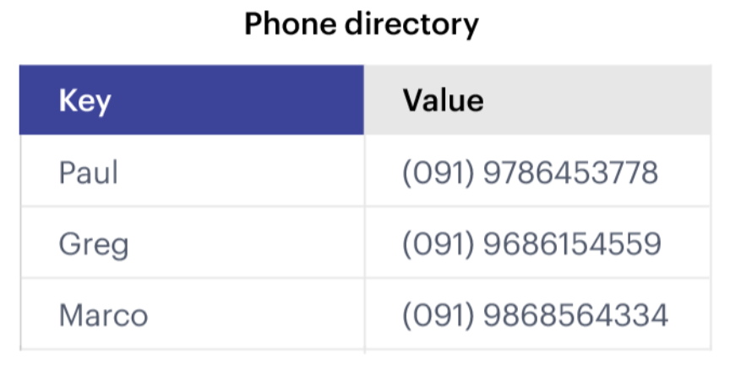


What is NoSQL?
Traditional Relational Database Management System (DBMS)
(Document Store)
(Key-Value Store)

Slide 6


Metaphor: NoSQL = No Rules?
Relational Databases
Non-Relational Databases (NoSQL)
NoSQL (Non-Relational Databases)

Slide 7

Who uses NoSQL?

Slide 8
Why NoSQL: Growth in Web Applications

Slide 9
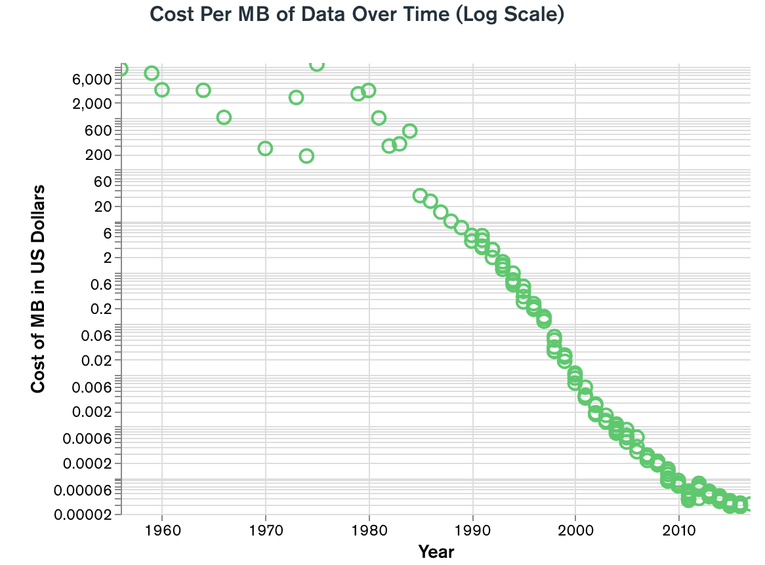
Why NoSQL: Volume, Velocity

Slide 10
A Brief Overview of NoSQL Systems
Horizontally scalability
Replicate/distribute data over many servers
Simple call interface
Often weaker concurrency model than RDBMS
Efficient use of distributed indexes and RAM
Flexible schemas
Volume, Velocity
Variety
Source: Cattell (2010). Scalable SQL and NoSQL Data Stores. SIGMOD Record.
Notes:
1. the ability to horizontally scale “simple operation” throughput over many servers
2. the ability to replicate and to distribute (partition) data over many servers,
3. a simple call level interface or protocol (in contrast to a SQL binding),
4. a weaker concurrency model than the ACID transactions of most relational (SQL) database systems
5. efficient use of distributed indexes and RAM for data storage
6. the ability to dynamically add new attributes to data records.

Slide 11
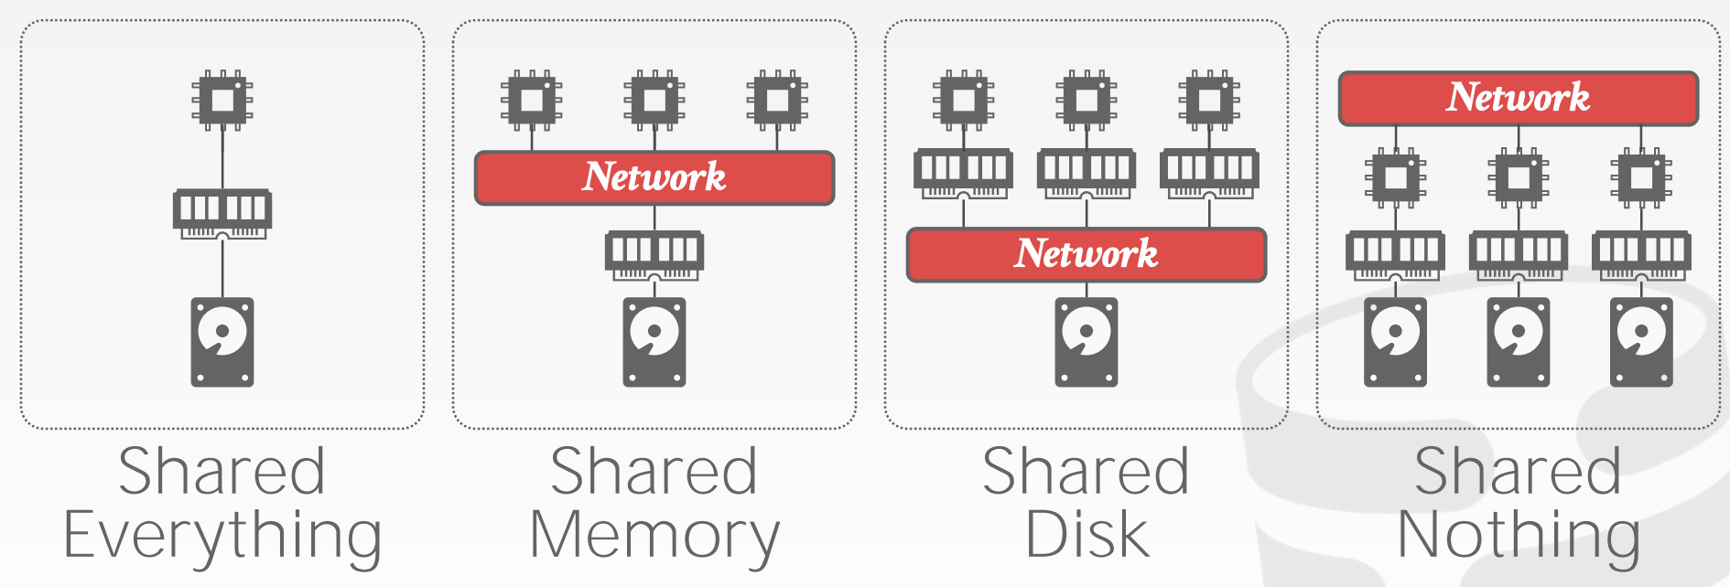










Distributed Database Architectures
Examples:
Single node DBMS
Supercomputers
Cloud databases
NoSQL (mostly)
Credit: Andy Pavlo (CMU CS15-446)
Notes:
Shared Nothing:
-reduce conflicts
-high scalability
-reduced I/O bottleneck

Slide 12
Assumption of Distributed Database
All nodes in a distributed database are well-behaved (i.e. they follow the protocol we designed for them; not ‘adversarial’ or trying to corrupt the database)
(Out of syllabus: If we cannot trust the other nodes, we need a Byzantine Fault Tolerant protocol; blockchains fall into this category)

Slide 13
Data Transparency
Users should not be required to know how the data is physically distributed, partitioned, or replicated.
A query that works on a single node database should still work on a distributed database.

Slide 14
Today’s Plan
What is NoSQL?
Major types of NoSQL systems
Eventual Consistency
Duplication
Data Partitioning
Query Processing in NoSQL
Source: Cattell (2010). Scalable SQL and NoSQL Data Stores. SIGMOD Record.

Slide 15




(Major) Types of NoSQL databases
Key-value stores
Wide column databases
Document stores
Graph databases

Slide 16

Key-Value Stores
Source: Wikipedia (Keychain)
Notes:
It supports very simple but flexible data models.

Slide 17
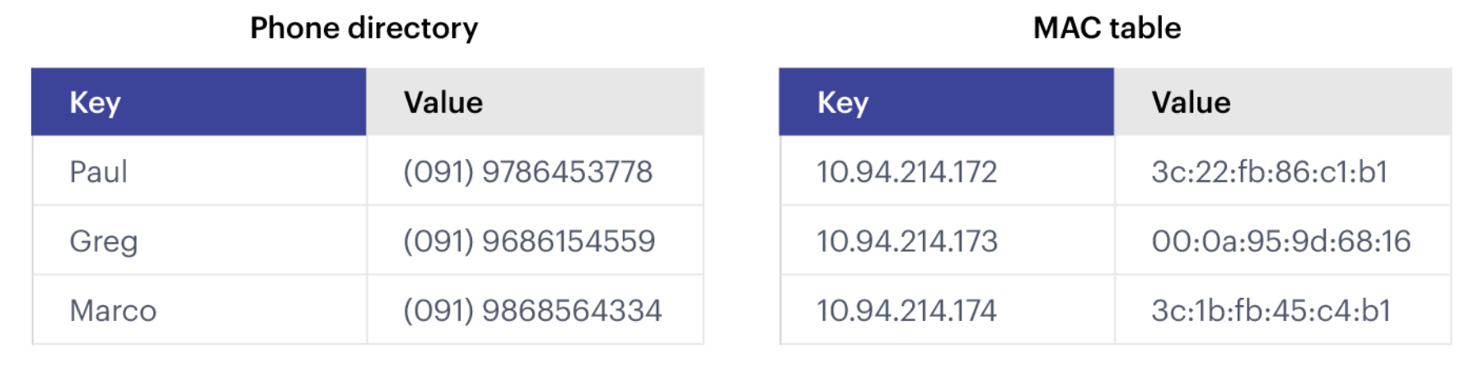
Key-Value Stores: Data Model
Stores associations between keys and values
Based on Amazon’s Dynamo paper (2007)
Keys are usually primitives and can be queried
For example, ints, strings, raw bytes, etc.
Values can be primitive or complex; usually cannot be queried
Examples: ints, strings, lists, JSON, HTML fragments, BLOB (basic large object), etc.
DeCandia, Giuseppe, et al. "Dynamo: Amazon's highly available key-value store." ACM SIGOPS operating systems review 41.6 (2007): 205-220.
Notes:
Dynamo pioneered the idea of eventual consistency as a way to achieve higher availability and scalability: data fetched are not guaranteed to be up-to-date, but updates are guaranteed to be propagated to all nodes eventually.
BLOB: most often they are unstructured data, e.g. video, audio, image, graphics.

Slide 18
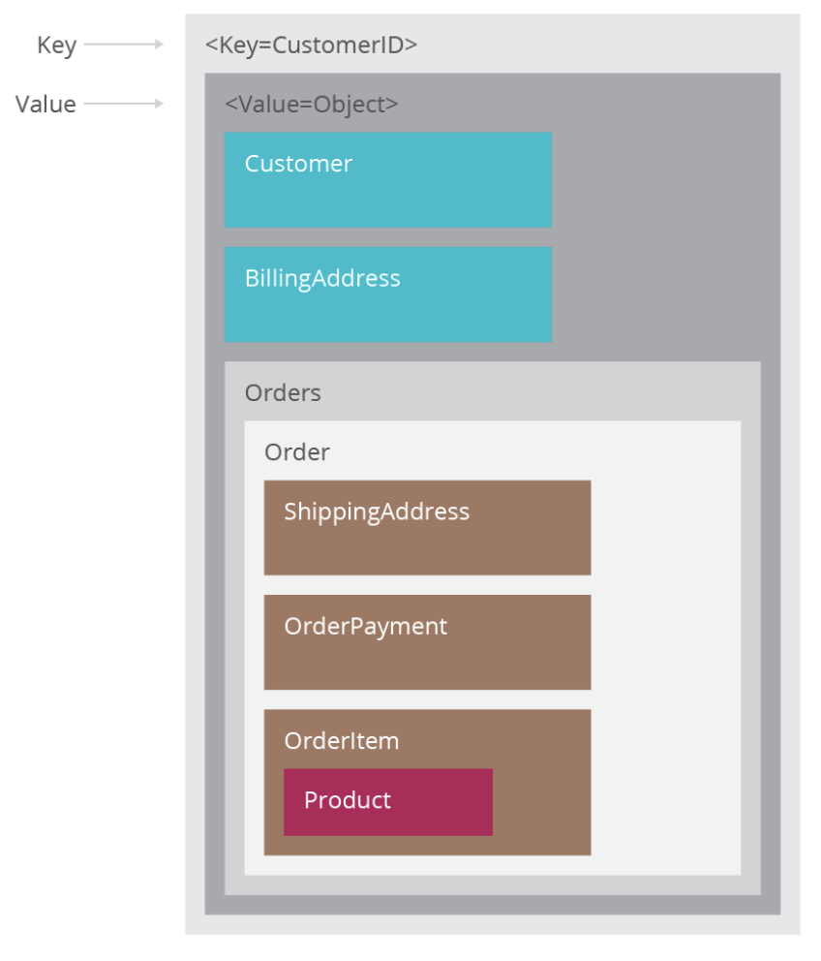
Key-Value Stores: Operations
Very simple API:
Get – fetch value associated with key
Put – set value associated with key
Optional operations:
Multi-get
Multi-put
Range queries
Suitable for:
Small continuous read and writes
Storing ‘basic’ information (e.g. raw chunks of bytes), or no clear schema
When complex queries are not required / rarely required
Example Applications
Storing user sessions
Caches
User data that is often processed individually: e.g. patient medical data?
Only if no queries like ‘How many patients who took X treatment recovered?’

Slide 19
Key-Value Stores: Implementation
Non-persistent:
Just a big in-memory hash table
Examples: Memcached, Redis
(But: these can also back up the data to disk periodically)
Persistent
Data is stored persistently to disk
Examples: RocksDB, Dynamo, Riak

Slide 20
Document Stores
DeCandia, Giuseppe, et al. "Dynamo: Amazon's highly available key-value store." ACM SIGOPS operating systems review 41.6 (2007): 205-220.
Source: Wikipedia (Keychain)

Slide 21
Document Stores: Document Model
ID
Field
Document
Value
Document
Collection
A database can have multiple collections
Collections have multiple documents
A document is a JSON-like object: it has fields and values
Different documents can have different fields
Can be nested: i.e. JSON objects as values

Slide 22
Document Stores: Querying
Unlike (basic) key value stores, document stores allow some querying based on the content of a document
CRUD = Create, Read, Update, Delete

Slide 23
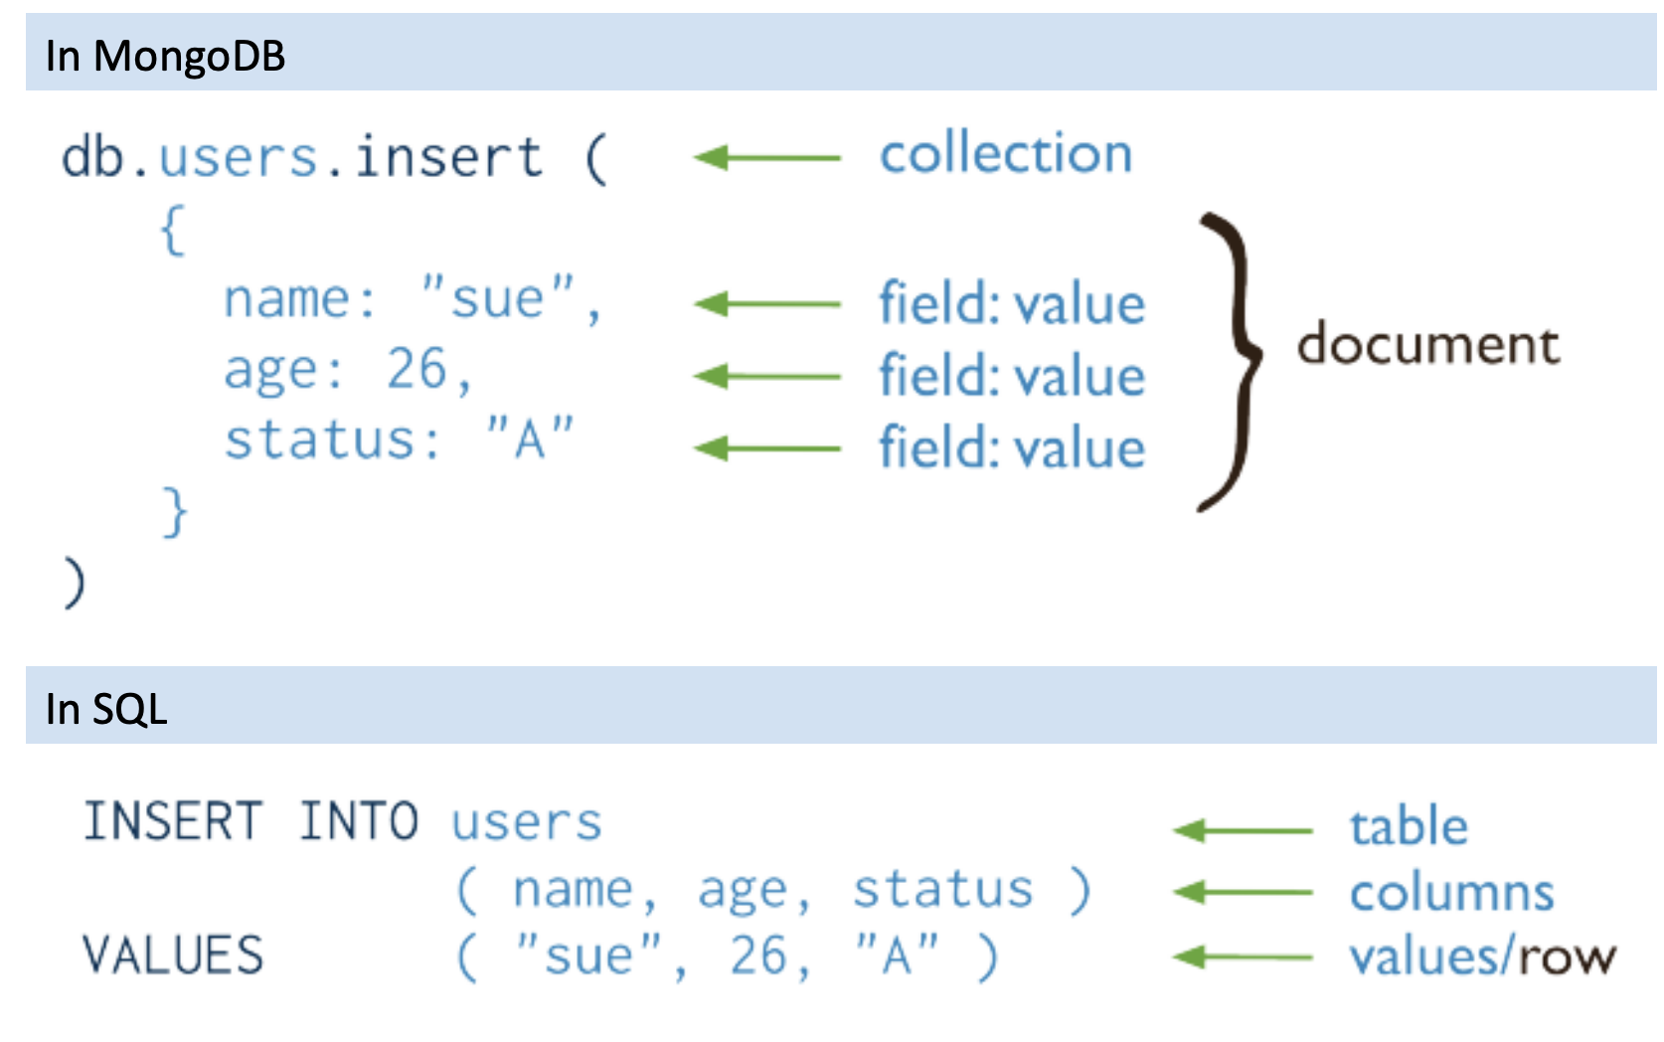
CRUD: Create

Slide 24
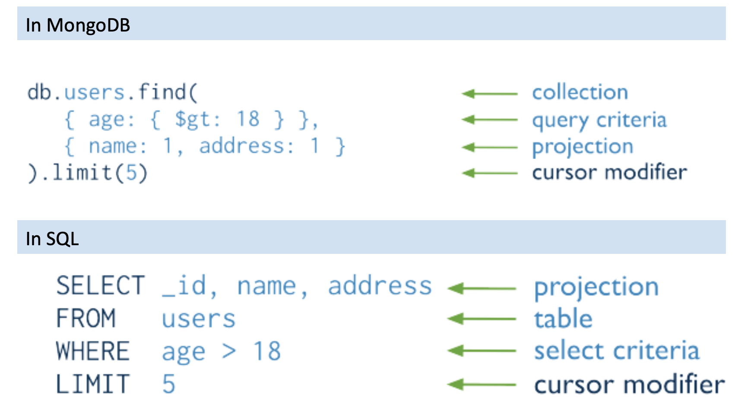
CRUD: Read

Slide 25
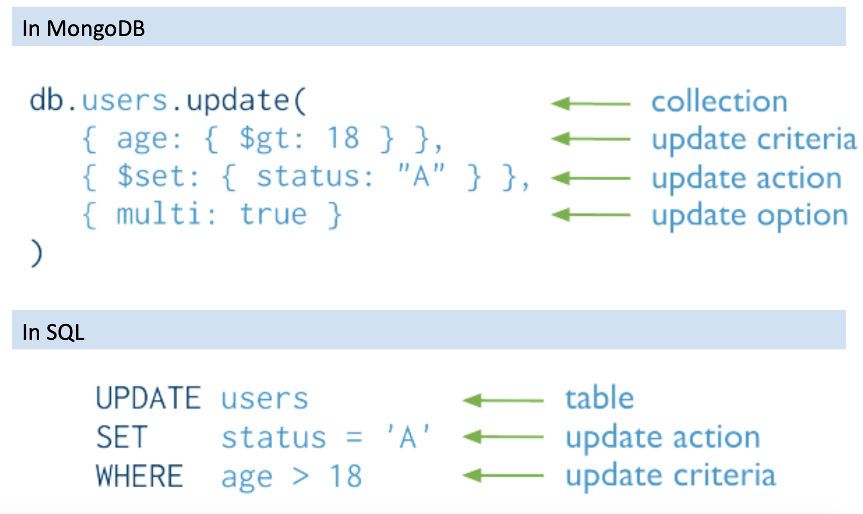
CRUD: Update

Slide 26
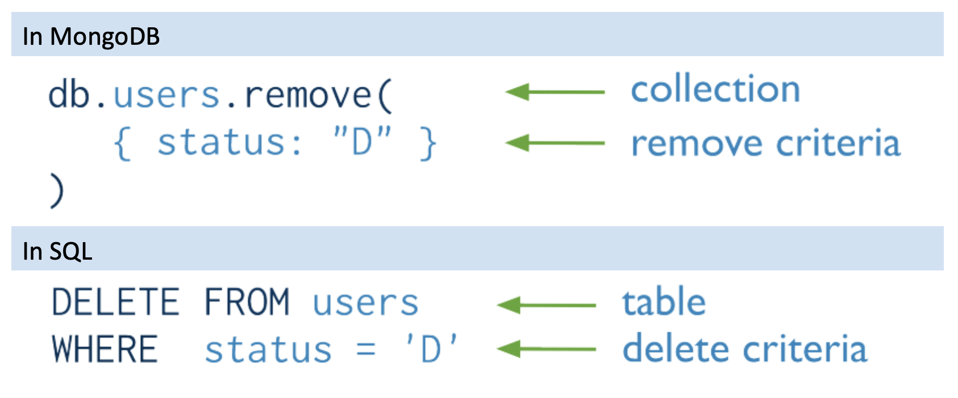
CRUD: Delete

Slide 27
Wide Column Stores
Rows describe entities
Related groups of columns are grouped as column families
Sparsity: if a column is not used for a row, it doesn’t use space
Examples: BigTable, Cassandra, HBase
https://cloud.google.com/bigtable/docs/overview

Slide 28
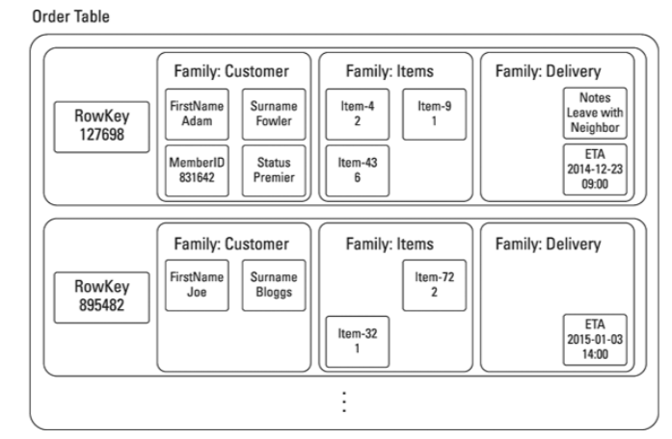
An example of BigTable (an order table)

Slide 29
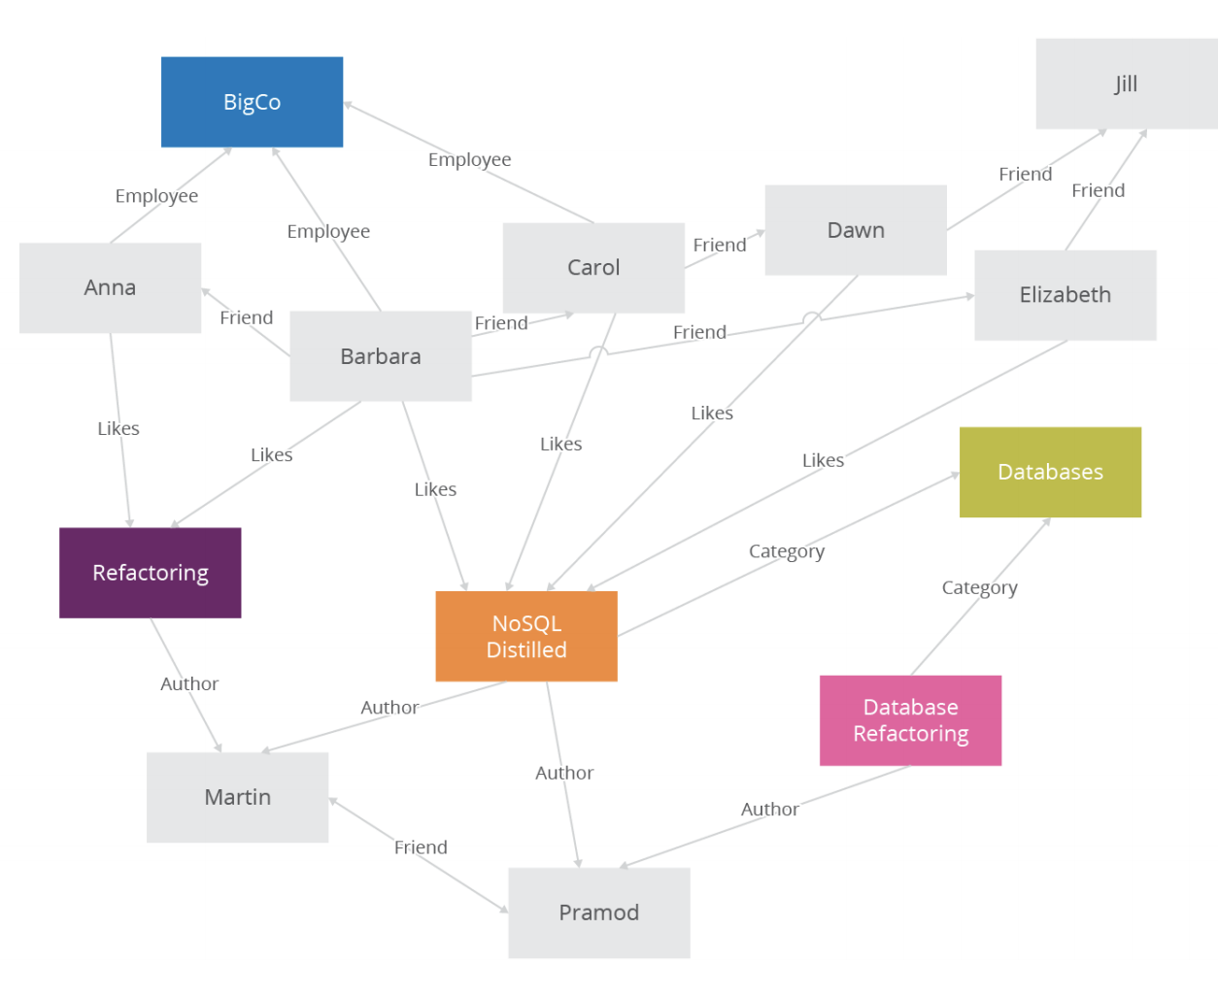
Graph Databases

Slide 30
Today’s Plan
What is NoSQL?
Major types of NoSQL systems
Eventual Consistency
Duplication
Data Partitioning
Query Processing in NoSQL
Source: Cattell (2010). Scalable SQL and NoSQL Data Stores. SIGMOD Record.

Slide 31
Strong vs Eventual Consistency
Weight=50kg
Weight=50kg
Weight=50kg
Weight=50kg
Weight=50kg
Weight=50kg
Strong consistency: any reads immediately after an update must give the same result on all observers
Eventual consistency: if the system is functioning and we wait long enough, eventually all reads will return the last written value

Slide 32
Strong vs Eventual Consistency
Weight=60kg
Weight=60kg
Weight=60kg
Weight=60kg
Weight=50kg
Weight=60kg
60kg
60kg
60kg
50kg
Strong consistency: any reads immediately after an update must give the same result on all observers
Eventual consistency: if the system is functioning and we wait long enough, eventually all reads will return the last written value

Slide 33
Strong vs Eventual Consistency
Weight=60kg
Weight=60kg
Weight=60kg
Weight=60kg
Weight=60kg
Weight=60kg
60kg
60kg
60kg
50kg
Strong consistency: any reads immediately after an update must give the same result on all observers
Eventual consistency: if the system is functioning and we wait long enough, eventually all reads will return the last written value

Slide 34
Eventual Consistency
Relational DBMS provide stronger (ACID) guarantees
Atomicity: all changes in one transaction either succeed or fail as a complete unit.
Consistency: database transitions from one consistent state at the beginning of the transaction to another consistent state at the end of the transaction.
Isolation: concurrent transactions are not affecting each other
Durability: persistence of committed transactions even under system failure
But many NoSQL system relax this to weaker “BASE” approach:
Basically Available: basic reading and writing operations are available most of the time
Soft State: the state of the data could change without application interactions due to eventual consistency
Eventually Consistent: Contrast to “strong consistency”
Notes:
Atomicity, Consistency, Isolation, Durability (ACID)
Atomicity ensures that all changes made to the database are executed as a single
operation. This means that the transaction succeeds only when all changes have been
performed successfully. For example, when I use my online banking system to transfer
money from savings to checking, the consistency property will guarantee that the
operation will only succeed when the money is deducted from my savings account
and added to my checking account. The complete operation will either succeed or fail
as a complete unit.
The Consistency property guarantees that database transitions from one consistent
state at the beginning of the transaction to another consistent state at the end of the
transaction. In our earlier example, the transfer of the money would only happen if
my savings account had sufficient funds. If not, the transaction would fail, and the
balances would stay in their original, consistent state.
Isolation ensures that concurrent operations that are happening within the database
are not affecting each other. This property ensures that when multiple transactions
are executed concurrently, their operations do not interfere with each other.
Durability refers to the persistence of committed transactions. It guarantees that
once a transaction is completed successfully, it will result in a permanent state even in
the event of a system failure. In our money transfer example, durability will ensure
that updates made to both my savings and checking account are persistent and can
survive a potential system failure.

Slide 35
Strong vs Eventual Consistency
Strong consistency
Eventual consistency
Implications: eventual consistency offers better availability at the cost of a much weaker consistency guarantee. This may be acceptable for some applications (e.g. statistical queries, tweets, social network feed, …) but not for others (e.g. financial transactions)
Note that while NoSQL systems allow for weaker consistency guarantees, many more recent systems / versions are often configurable, i.e. can be configured for multiple different consistency levels (including strong) – ‘tunable consistency’

Slide 36
Today’s Plan
What is NoSQL?
Major types of NoSQL systems
Eventual Consistency
Duplication
Data Partitioning
Query Processing in NoSQL
Source: Cattell (2010). Scalable SQL and NoSQL Data Stores. SIGMOD Record.

Slide 37
Recall: Joins in RDBMS
Posts
Users
user_id | name
100 | Alice
101 | Bob
post_id | post | user_id
1 | Hello world | 100
2 | Bye world | 101
post_id | post | user_id | name
1 | Hello world | 100 | Alice
2 | Bye world | 101 | Bob

Slide 38
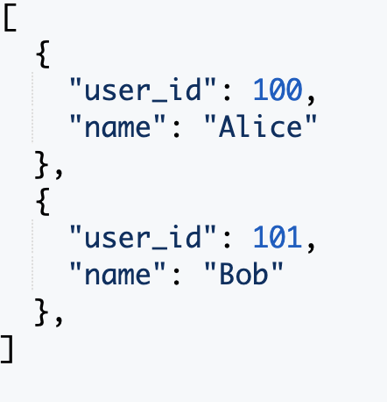
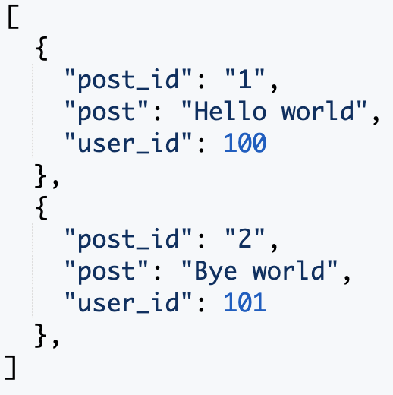
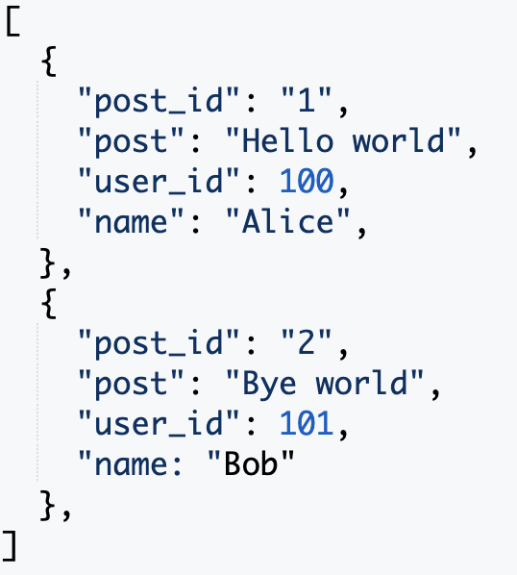
What if we want to display posts with usernames?
Users
Posts
Posts ( + username)
Answer 1: some NoSQL databases do support joins (e.g. later versions of MongoDB)
Answer 2: Duplication (i.e. ‘denormalization’)
‘Storage is cheap: why not just duplicate data to improve efficiency?’
Tables are designed around the queries we expect to receive. This is beneficial especially when we mostly need to process a fixed type of queries
Leads to a new problem: what if user changes their name? (this needs to be propagated to multiple tables)
Notes:
Unlike relational DBs where queries may require looking up multiple tables (joins), using duplication in NoSQL allows queries to go to only 1 collection.
Duplication means that when updating the table, there is additional costs involved in keeping the tables in sync. So this is a tradeoff between fast reads and writes but additional update costs in NoSQL. In some cases updates may be rare, or even can be ignored, i.e. we allow the tables to go out of sync, which may be fine for some applications (e.g. it may be fine to display a post with the user name “at time of posting”). So in the end it is a tradeoff that has to be carefully made based on profiling, application / business needs etc.

Slide 39
Today’s Plan
What is NoSQL?
Major types of NoSQL systems
Eventual Consistency
Duplication
Data Partitioning
Query Processing in NoSQL
Source: Cattell (2010). Scalable SQL and NoSQL Data Stores. SIGMOD Record.

Slide 40
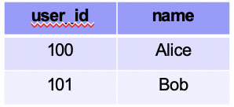
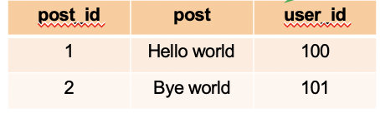
Table Partitioning
Put different tables (or collections) on different machines
Partition 1
Partition 2
Problem: scalability – each table cannot be split across multiple machines

Slide 41
Horizontal Partitioning
Different tuples are stored in different nodes
Partition Key
Partition 1
Partition 2
user_id | name
100 | Alice
101 | Bob
user_id | name
100 | Alice
user_id | name
101 | Bob
Also called “sharding”
Partition Key (or “shard key”) is the variable used to decide which node each tuple will be stored on: tuples with the same shard key will be on the same node
How to choose partition key? If we often need to filter tuples based on a column, or “group by” a column, then that column is a suitable partition key
Example: if we filter tuples by user_id=100, and user_id is the partition key, then all the user_id=100 data will be on the same partition. Data from other partitions can be ignored (called ‘partition pruning’), which saves time as we don’t have to scan these tuples.

Slide 42
Horizontal Partitioning
Different tuples are stored in different nodes
Partition Key
Partition 1
Partition 2
user_id | name
100 | Alice
101 | Bob
user_id | name
100 | Alice
user_id | name
101 | Bob
Q: imagine using each user’s city, city_id as a partition key; when is this good / bad?

Slide 43
Horizontal Partitioning
Different tuples are stored in different nodes
Partition Key
Partition 1
Partition 2
user_id | name
100 | Alice
101 | Bob
user_id | name
100 | Alice
user_id | name
101 | Bob
Q: imagine using each user’s city, city_id as a partition key; when is this good / bad?
A: good if we mostly aggregate data only within individual cities. Bad if there are too few cities (or cities are very imbalanced) and this causes a lack of scalability.

Slide 44
Horizontal Partitioning – Range Partition
Different tuples are stored in different nodes
Partition Key
Partition 1
Partition 2
user_id | name
100 | Alice
101 | Bob
1 ≤ user_id ≤ 100
101 ≤ user_id < 200
user_id | name
100 | Alice
user_id | name
101 | Bob
Range Partition: split partition key based on range of values
Beneficial if we need range-based queries. In the above example, if the user queries for user_id < 50, all the data in partition 2 can be ignored (‘partition pruning’); this saves a lot of work
But: range partitioning can lead to imbalanced shards, e.g. if many rows have user_id = 0
Splitting the range is automatically handled by a balancer (it tries to keep the shards balanced)

Slide 45
Horizontal Partitioning – Hash Partition
Different tuples are stored in different nodes
Partition Key
Partition 1
Partition 2
user_id | name
100 | Alice
101 | Bob
1 ≤ hash(100) ≤ 16
17 ≤ hash(101) < 32
user_id | name
100 | Alice
user_id | name
101 | Bob
Hash Partition: hash partition key, then divide that into partitions based on ranges
Hash function automatically spreads out partition key values roughly evenly
Question: in previous approaches, how to add / remove a node? If we completely redo the partition, a lot of data may have to be moved around, which is inefficient.
Answer: consistent hashing

Slide 46
Consistent Hashing
Think of the output of the hash function as lying on a circle:
31
0
1
Partition Key
…
10
user_id | name
100 | Alice
101 | Bob
hash(100)=10
hash(101)=25
25

Slide 47
Consistent Hashing
Think of the output of the hash function as lying on a circle:
31
0
1
Partition Key
…
Node 2
10
user_id | name
100 | Alice
101 | Bob
hash(100)=10
hash(101)=25
25
Node 3
Node 1
How to partition: each node has a ‘marker’ (rectangles)

Slide 48
Consistent Hashing
Think of the output of the hash function as lying on a circle:
31
0
1
Partition Key
…
Node 2
10
user_id | name
100 | Alice
101 | Bob
hash(100)=10
hash(101)=25
25
Node 3
Node 1
How to partition: each node has a ‘marker’ (rectangles)
Each tuple is placed on the circle, and assigned to the node that comes clockwise-after it

Slide 49
Consistent Hashing
Think of the output of the hash function as lying on a circle:
31
0
1
Partition Key
…
Node 2
10
user_id | name
100 | Alice
101 | Bob
hash(100)=10
hash(101)=25
25
Node 3
Node 1
How to partition: each node has a ‘marker’ (rectangles)
Each tuple is placed on the circle, and assigned to the node that comes clockwise-after it
To delete a node, we simply re-assign all its tuples to the node clock-wise after this one

Slide 50
Consistent Hashing
Think of the output of the hash function as lying on a circle:
31
0
1
Partition Key
…
Node 2
10
user_id | name
100 | Alice
101 | Bob
hash(100)=10
hash(101)=25
25
Node 3
Node 1
How to partition: each node has a ‘marker’ (rectangles)
Each tuple is placed on the circle, and assigned to the node that comes clockwise-after it
To delete a node, we simply re-assign all its tuples to the node clock-wise after this one
Similarly, nodes can be added by splitting the largest current node into two

Slide 51
Consistent Hashing
Think of the output of the hash function as lying on a circle:
31
0
1
Partition Key
…
Node 2
10
user_id | name
100 | Alice
101 | Bob
hash(100)=10
hash(101)=25
25
Node 3
Node 1
Simple replication strategy: replicate a tuple in the next few (e.g. 2) additional nodes clockwise after the primary node used to store it

Slide 52
Consistent Hashing
31
0
1
Partition Key
…
Node 1
user_id | name
100 | Alice
101 | Bob
Node 2
10
hash(100)=10
hash(101)=25
25
Node 3
Node 3
Node 2
Node 1
Multiple markers: we can also have multiple markers per node. For each tuple, we still assign it to the marker nearest to it in the clockwise direction.
Benefit: when we remove a node (e.g. node 1), its tuples will not all be reassigned to the same node. So, this can balance load better.

Slide 53
Today’s Plan
What is NoSQL?
Major types of NoSQL systems
Eventual Consistency
Duplication
Data Partitioning
Query Processing in NoSQL
Source: Cattell (2010). Scalable SQL and NoSQL Data Stores. SIGMOD Record.

Slide 54
Architecture of MongoDB
Routers (mongos): handle requests from application and route the queries to correct shards
Config Server: stores metadata about which data is on which shard
Shards: store data, and run queries on their data

Slide 55
Example of Read or Write Query
find({‘class’:’cs4225’})
{‘name’:’alice’,’class’:’cs4225’}
{‘name’:’bob’,’class’:’cs4225’}
find({‘class’:’cs4225’})
{‘name’:’alice’,’class’:’cs4225’}
{‘name’:’bob’,’class’:’cs4225’}
find({‘class’:’cs4225’})
find({‘class’:’cs4225’})
{‘name’:’alice’,’class’:’cs4225’}
{‘name’:’bob’,’class’:’cs4225’}
Query is issued to a router (mongos) instance
With help of config server, mongos determines which shards should be queried
Query is sent to relevant shards
Shards run query on their data, and send results back to mongos
mongos merges the query results and returns the merged results

Slide 56
Conclusion: Key Features of NoSQL Systems
Horizontal partitioning: as we get more and more data, we can simply partition it into more and more shards (even if individual tables become very large)
Horizontal partitioning improves speed due to parallelization.
Relaxed consistency guarantees: prioritize availability over consistency – can return slightly stale data
Flexible schema: make it easier to adapt applications to changing requirements

Slide 57


Conclusion: Pros & Cons of NoSQL Systems
Pros
Cons
+ Flexible / dynamic schema: suitable for less well-structured data
+ Horizontal scalability: improves speed due to parallelization
+ High performance and availability: due to their relaxed consistency model and fast reads / writes
- No declarative query language: query logic (e.g. joins) may have to be handled on the application side, which can add additional programming
- Weaker consistency guarantees: application may receive stale data that may need to be handled on the application side
Source: Cattell (2010). Scalable SQL and NoSQL Data Stores. SIGMOD Record.

Slide 58
Conclusion: no one size fits all
When it comes to select a proper data store, it depends on
needs of application: whether denormalization is suitable;
complexity of queries (joins vs simple read/writes);
importance of consistency (e.g. financial transactions vs tweets);
data volume / need for availability / data relationships
In addition:
Binary view is oversimplified: NoSQL databases often still have SQL-like query languages (e.g. Cassandra) and tunable consistency levels.
Other alternative solutions: “NewSQL”, distributed SQL (e.g. Presto), PostgreSQL, …
Need to understand tradeoffs to make an informed decision!
Source: Cattell (2010). Scalable SQL and NoSQL Data Stores. SIGMOD Record.

Slide 59
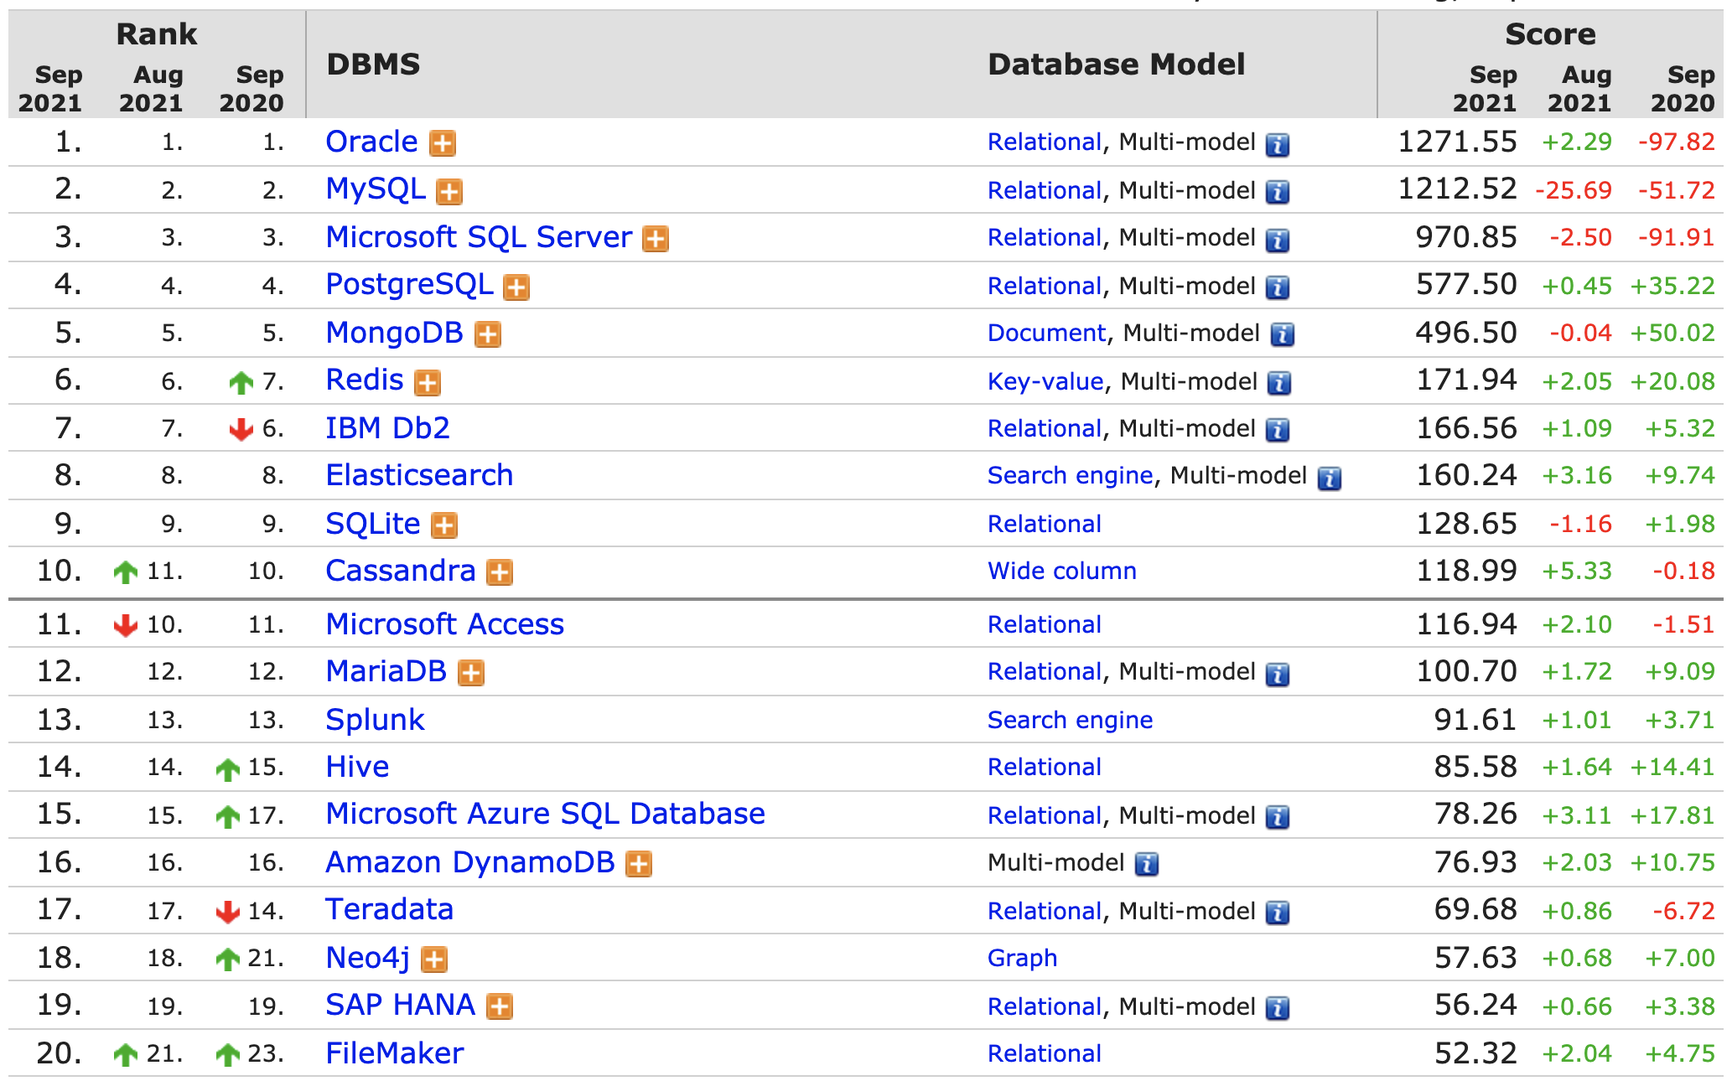
Popularity of DBMS

Slide 60
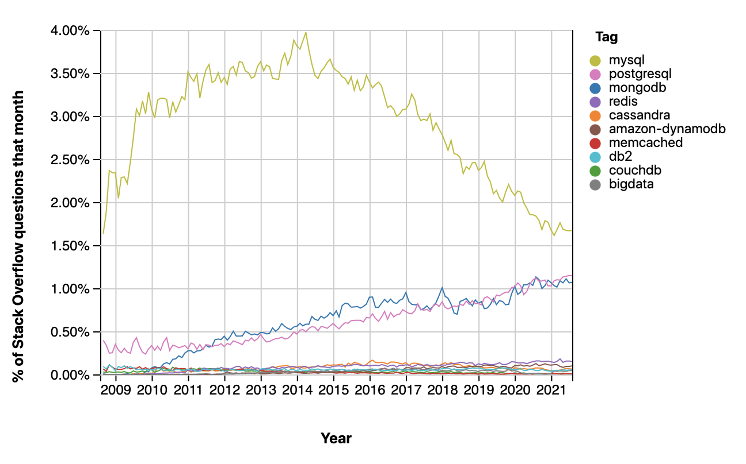
Stack Overflow Trends
Source: https://insights.stackoverflow.com/
Notes:
https://www.guru99.com/postgresql-vs-mysql-difference.html
Postgresql: Support JSON and other NoSQL features like native XML support. It also allows indexing JSON data for faster access.
Mysql: MySQL has a JSON data type support but does not support any other NoSQL feature.

Slide 61
Acknowledgements
CS4225 slides by He Bingsheng and Bryan Hooi
Penn State CMPSC 431W Database Management Systems (Fall 2015) – McGrawHill, Wang-Chien Lee, Yu-San Lin
mongodb.com, redis.com
Otter video from https://www.reddit.com/r/singapore/comments/mezgg3/otters_on_the_grass_at_botanic_gardens_today/
CMU CS15-445 slides by Andy Pavlo
mongodb.com, https://learnmongodbthehardway.com/
Martin Kleppmann, “Designing Data-Intensive Applications”

